Slide 1



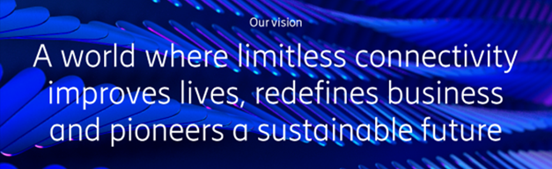





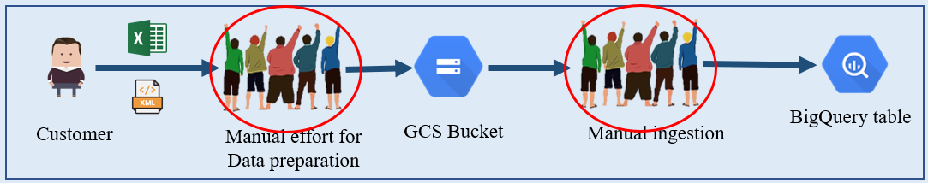


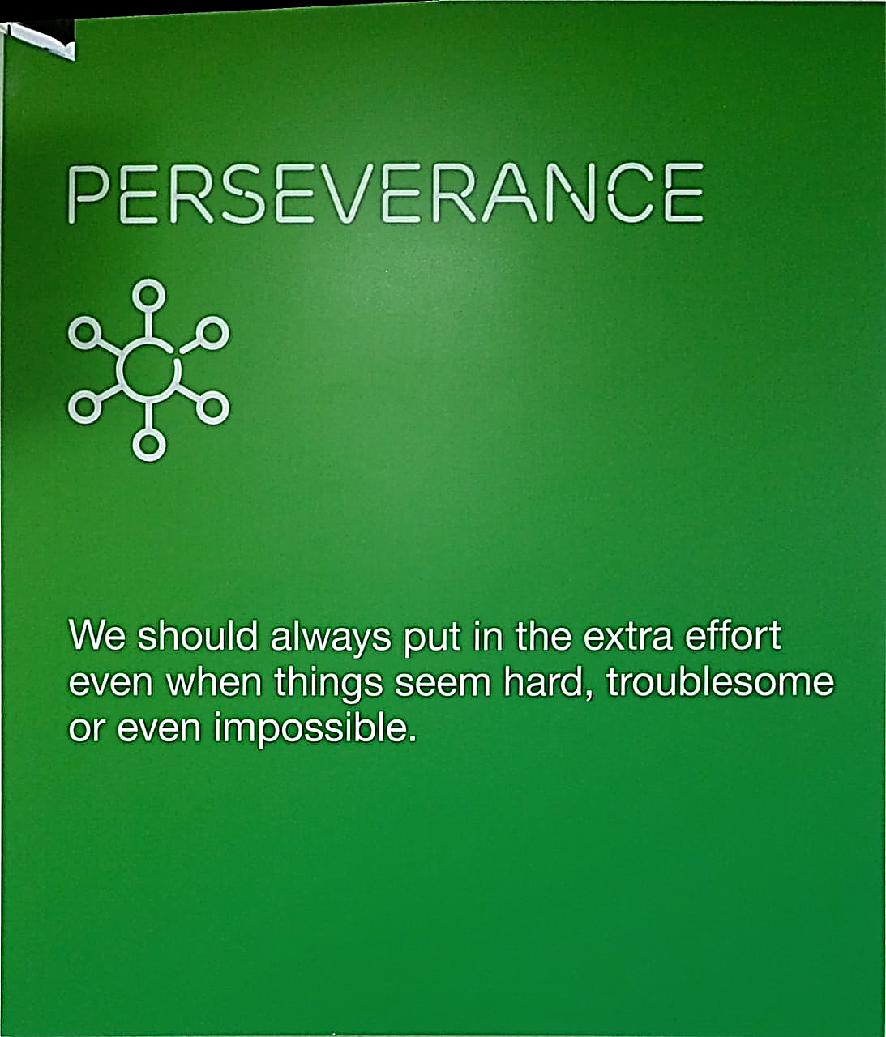

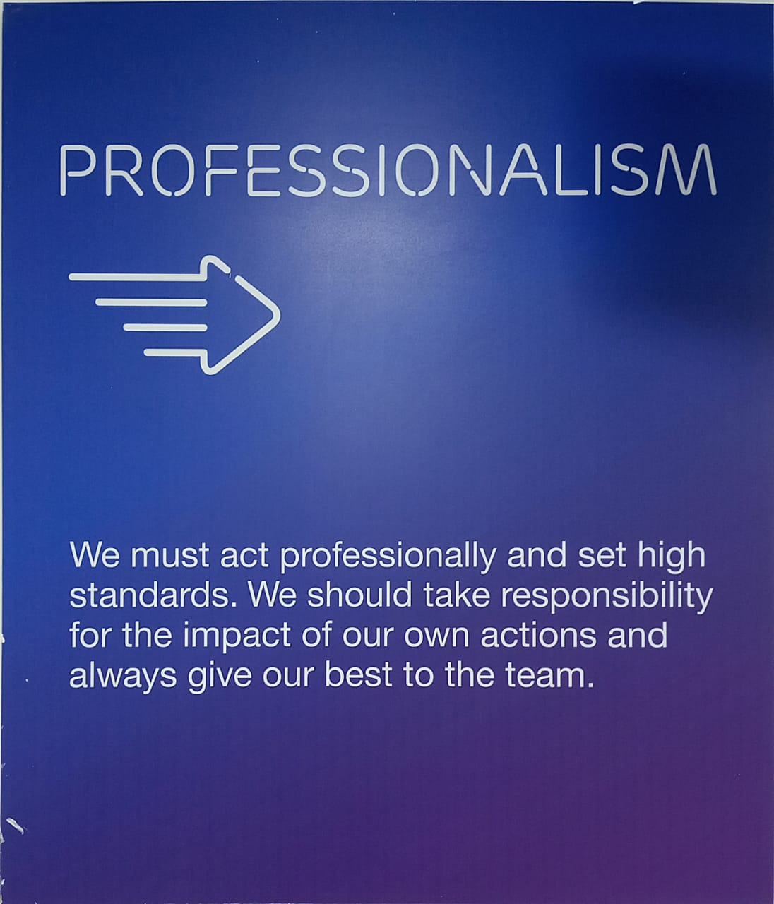
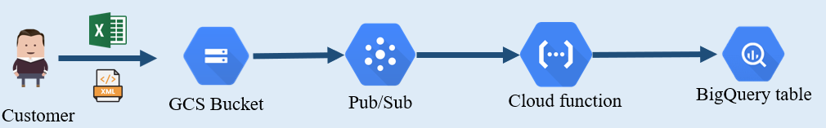








Project Title: Network & Service Automation using GCP
Company: Ericsson Global India Pvt. Ltd. Noida
About Student: Shubham Tiwari, 101916126, 4CSE12, Internship: Jan 25th – July 25th , 2023
About Company: EGI Pvt. Ltd
Is 5G pioneer
Provide communication Services
Provide connectivity solution
Have 60K+ Patents of ranges of Technologies i.e., Cellular IoT, 5G, Smartphones
About Internship: @ EGI Pvt. Ltd
Gained familiarity with internal tools and techniques
Did Udemy Course on GCP
Worked with GCP based Data Ingestion Automation
E2E Product development and deployment of above
Developing the solution for an internal tool needs to be rearchitected to make it lightweight.
Learnings - During Intern
Cloud Dataproc
Cloud Composer
Telecom
fundamentals
Problem 1: For Data Ingestion Automation
Too Expensive
Core-Values
Solution 1
Problem 2: Costly component GCP
Automation
Learnings - During College
Cloud Computing & Projects
Machine Learning & Projects
Python, Scala, DBMS, Docker
Elective – Edge AI & Robotics
GCS Bucket
Eventarc
Cloud Run
BigQuery
Looker
Solution 2:
Scheduler
Workflow
BigQuery

Slide 2

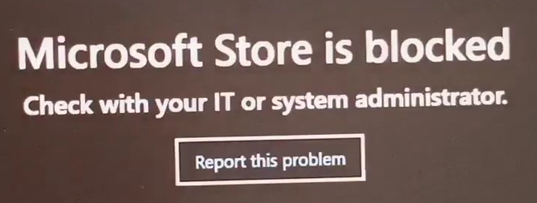




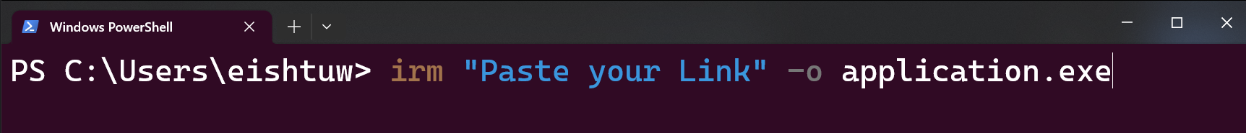
Download Applications
Without
Microsoft Store
PowerShell

